Slide 1
Marketing Campaigns of a Portuguese Banking Institution
ALY6020 81998 Predictive Analytics SEC 05 Spring 2020 CPS
Final Presentation
Group Member:
Ronak Somani,
Rui Wang,
Shreenidhi Pradeep Tarte
Bindu Mounika Vundrakonda

Slide 2
Roadmap
Logistic Regression
Conclusion
Random Forest
Decision Tree
EDA
Introduction
Business Problem & Objective
Data Visualization
Data Analysis & Prediction
Will results be helpful?
Data Analysis & Prediction
Data Analysis & Prediction
Data Description & Data Exploration

Slide 3
PART ONE
Introduction
Marketing of bank items is the total capacity retained at giving the office to fulfill client's financial needs more than the competition keeping in view the authoritative targets.
Banking is a customized service-oriented industry and subsequently ought to give services which fulfill the clients' needs. The marketing strategy incorporates grouping, reacting and fulfilling the clients' needs and needs effectively, expertly, and gainfully.
The fundamental job of the bank isn't just to achieve and win an ever-increasing number of clients but also to provide them with the best possible services.
Marketing as related with banking is to disclose an appropriate guarantee to a client through an assortment of items and administrations and furthermore to affirm usable dissemination through fulfillment.

Slide 4
PART ONE
Business Problem & Objective
There has been a revenue decline for the Portuguese bank, and they would like to know what actions to take. After investigation, we found out that the root cause is that their clients are not depositing as frequently as before.
Knowing that term deposits allow banks to hold onto a deposit for a specific amount of time, so banks can invest in higher gain financial products to make a profit.
In addition, banks also hold better chance to persuade term deposit clients into buying other products such as funds or insurance to further increase their revenues.
As a result, by using machine learning algorithm the Portuguese bank would like to identify existing clients that have higher chance to subscribe for a term deposit and focus marketing effort on such clients. Term deposit is defined as fixed-term investment that includes the deposit of money into an account at a financial institution.

Slide 5
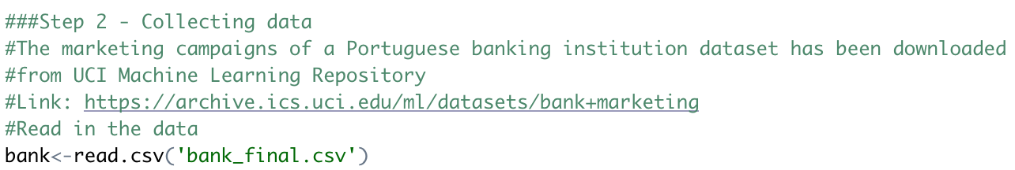
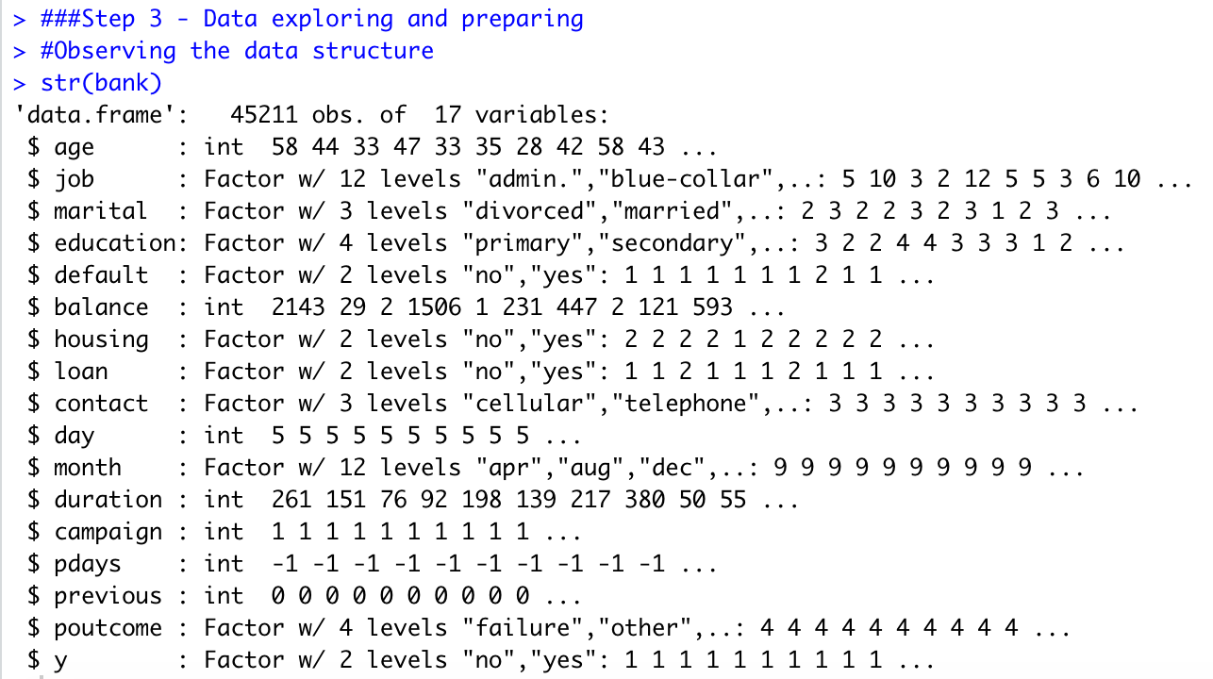
PART ONE
Data Description
The dataset is related with the marketing campaigns of a Portuguese banking institution. This data was picked up from UCI Machine Learning Repository.
Link: https://archive.ics.uci.edu/ml/datasets/bank+marketing
The marketing campaigns were based on phone calls. Often, more than one contact to the same client was required, in order to access if the product (bank term deposit) would be ('yes') or would not be ('no') subscribed.
The bank data has 45211 observations of 17 variables. There are 7 continuous measure variables like age, balance, duration, pdays etc. and 10 categorical variables like job, marital, housing, education etc.
The target variable (y) is a binary response indicating whether the client subscribed to a term deposit or not. “yes” (numeric value 1) indicated the client subscribed to a term deposit. “no” (numeric value 0) indicated the client did not subscribed to a term deposit.

Slide 6
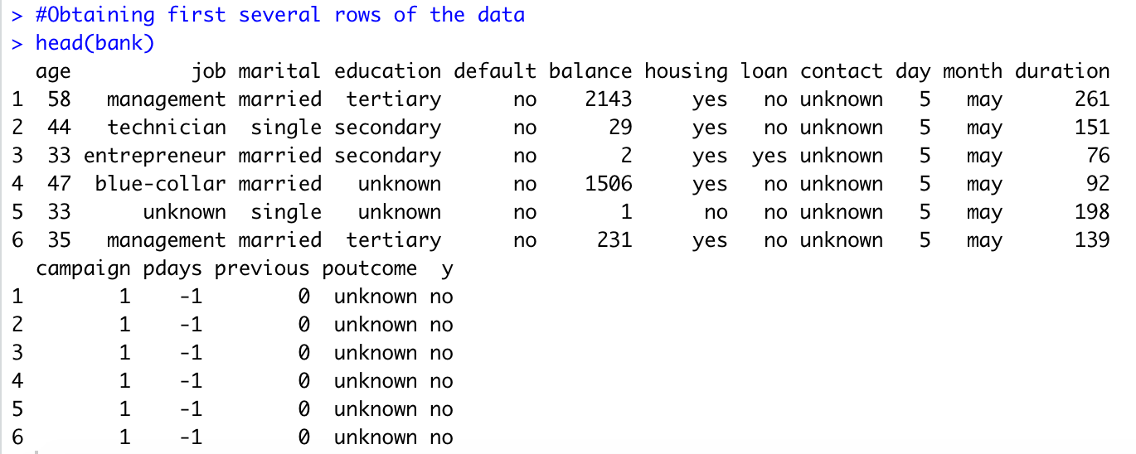
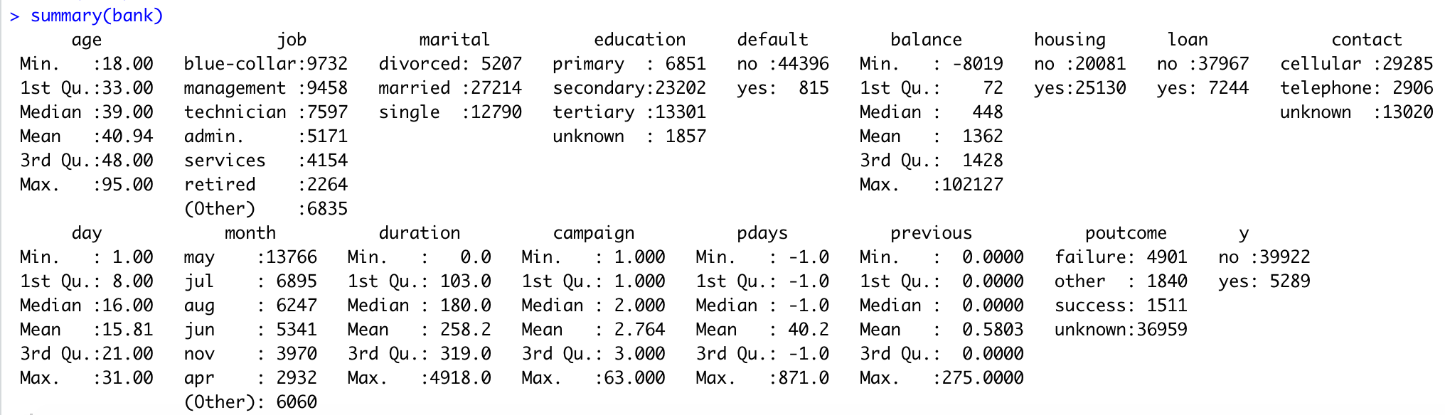
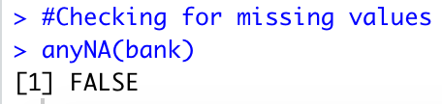
PART ONE
Data Exploration
Exploring the dataset using head function to see the first 6 rows.
The summary(bank) function is used for more detailed insights. For instance, for all the integer variables summary function can give us the descriptive statistics like min., max., mean, median and quantiles. Similarly, for factor variables it shows us the number of counts for each attribute inside a variable.
Checking for any NA values in the dataset
Using anyNA(bank) function, we can conclude that there are no NA values present in the dataset.

Slide 7
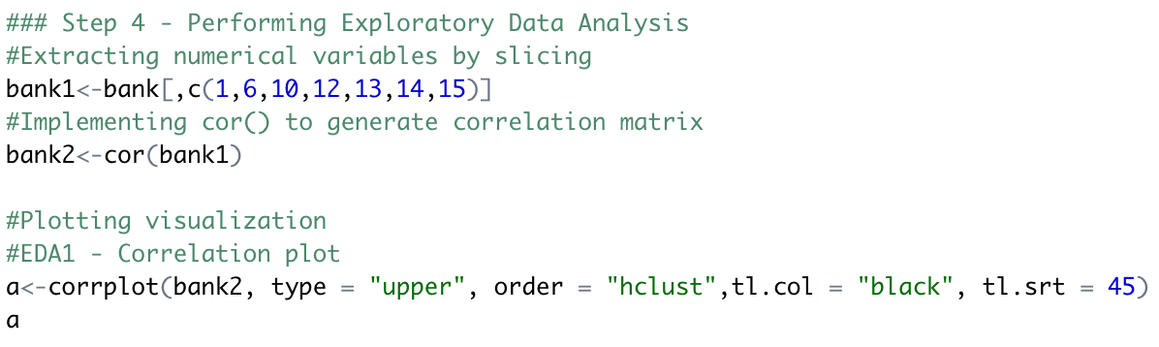
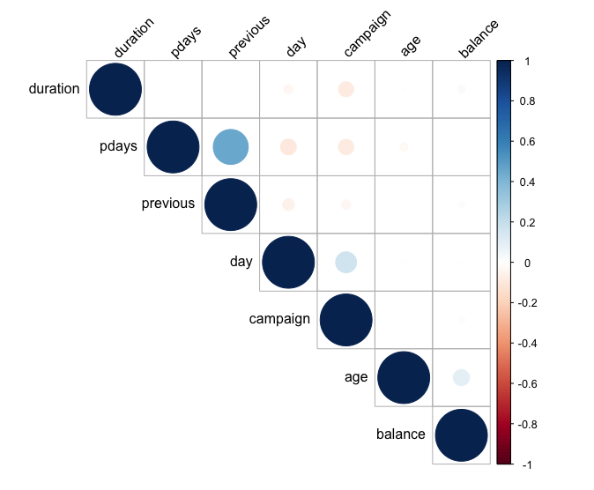
PART TWO
Exploratory Data Analysis – Correlation Matrix
Correlation matrix determines the degree of association between the numerical variables present in the data.
In our case numerical variables are age, balance, day, duration, campaign, pdays and previous.
We have first extracted the numerical variables by using slicing and stored it in variable bank1 and then implemented “cor()” function to generate correlation matrix called bank2. We have then used corrplot() function to visualize the correlation matrix.
From the correlation matrix, we infer that the variables are very weakly correlated with each other indicating that there is no approximately correlation between them which means there is very less multicollinearity, which is a good sign.

Slide 8
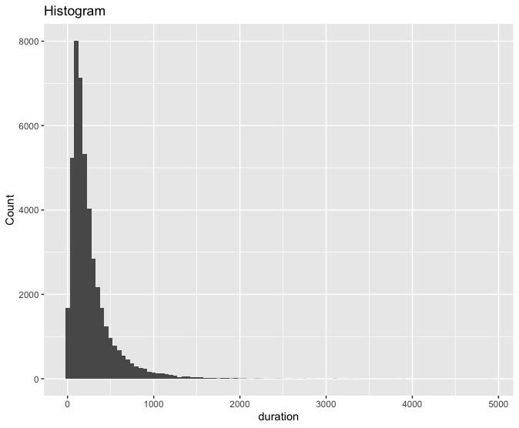
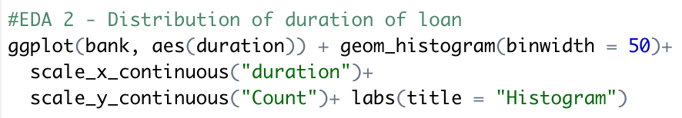
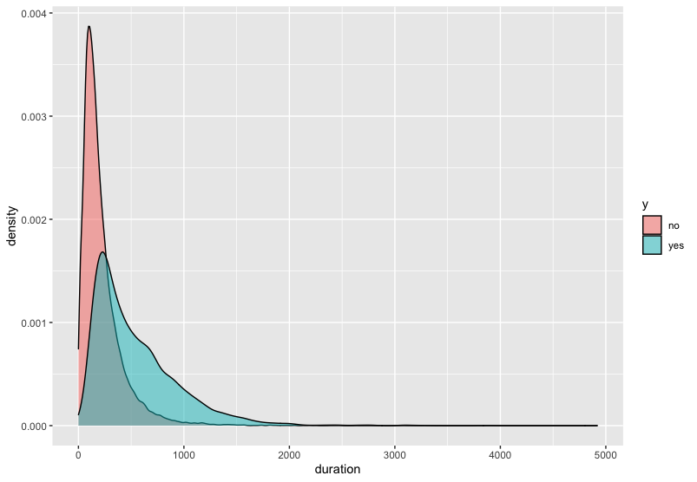
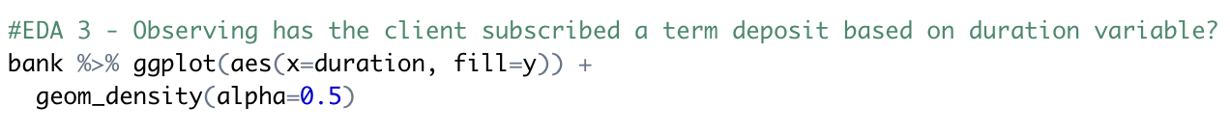
PART TWO
Exploratory Data Analysis
Distribution of duration of loan
Histogram determines the distribution of a continuous variable; we can determine whether our variable follows a normal distribution or is the distribution positively or negatively skewed. In our dataset we will be analyzing the distribution of the continuous variable duration using ggplot() function.
From the plot, we determine that most of the duration values are concentrated in the 0-500 seconds while there are very less values for more than 1000 seconds duration.
Observing if the client subscribed a term deposit based on duration variable?
Variable duration is a leakage and cannot be sensibly used in a predictive model as it is not known before a call is made. It is highly predictive of subscription, i.e. people who spent more time on the call were more likely to subscribe. Initial models which included this variable show that it had the highest importance.

Slide 9
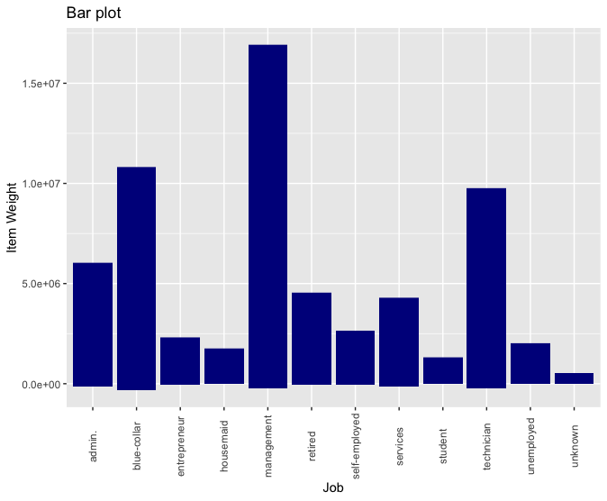
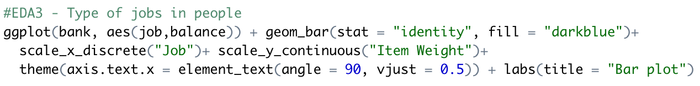
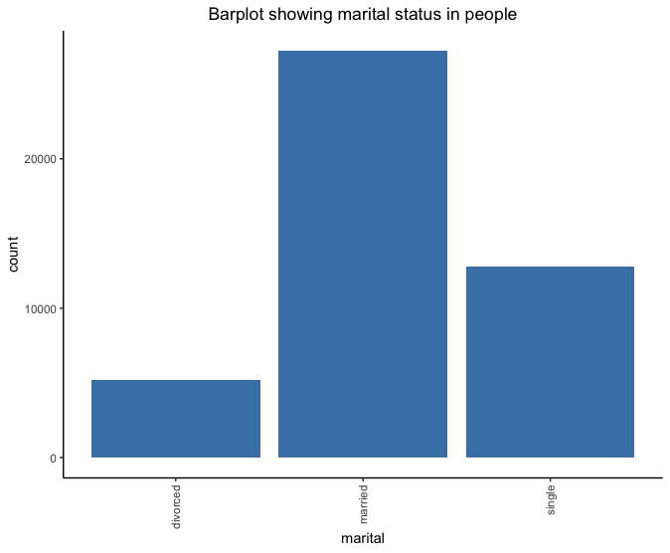
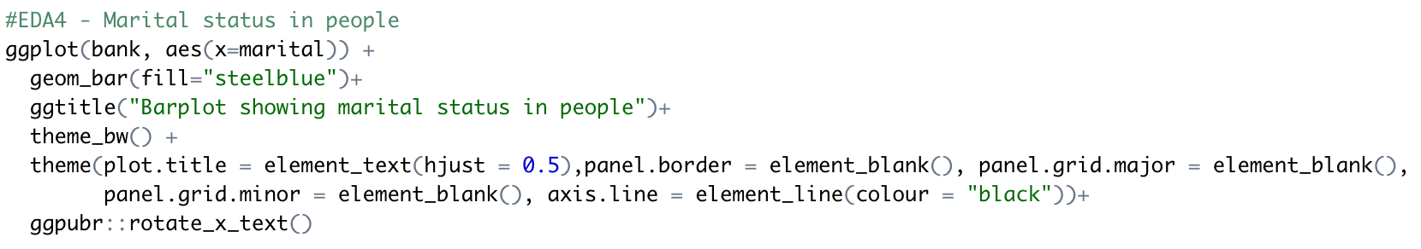
PART TWO
Exploratory Data Analysis
Types of jobs in people
Bar-plot determines the frequency of occurrence of a categorical variable in the dataset. In our dataset we have made a bar-plot of the outlet type variable versus the item weight.
From the plot, we determine that the job “management” had the most balance followed by “blue collar” and “technician”” making them most likely to be subscribed for the bank deposit term.
Marital status in people
This is to determine the kind of marital clients the bank has, and does it affect the loan default.
From the plot, we can assume that singles and married clients are most likely to be subscribed for the bank term deposit as compared to divorced clients.

Slide 10
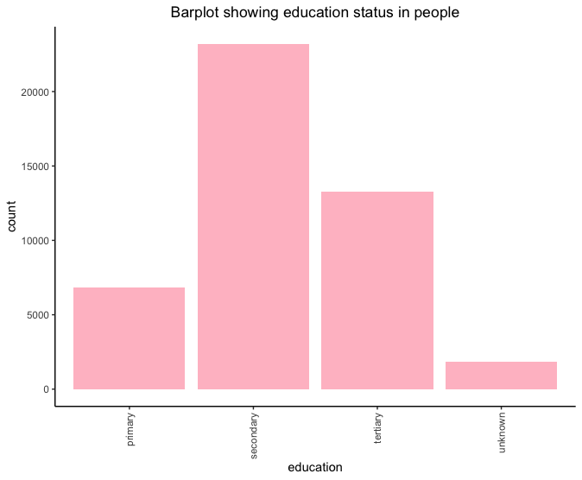
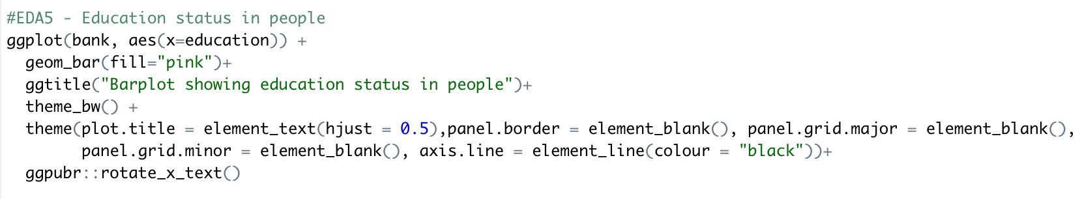
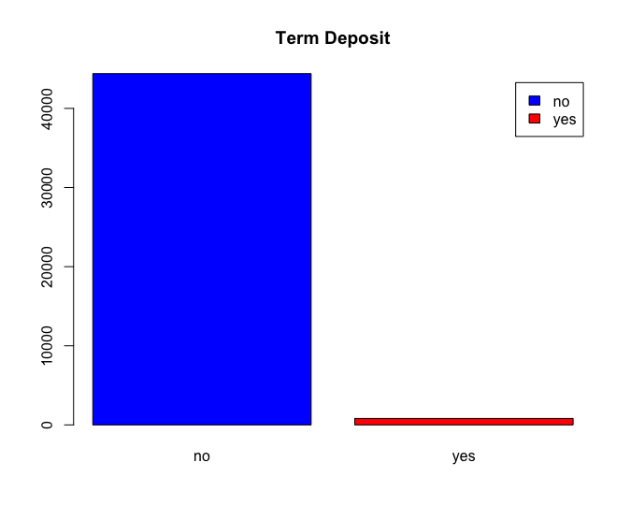
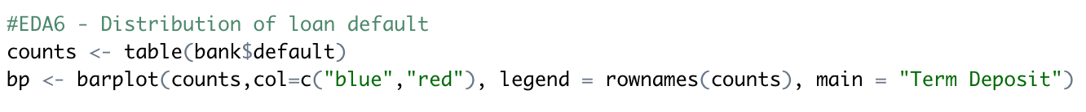
PART TWO
Exploratory Data Analysis
Education status in people
How educated are our clients?
From the plot, we can assume that clients who are more educated and have more experience are most likely to be subscribed for the bank term deposit as compared to less educated clients.
Distribution of loan default
This is to check how many people actually default on their loan.
From the graph, we can see that very few people default. This is a good indication for the bank as there will not be a problem in processing payments from the bank’s end.

Slide 11
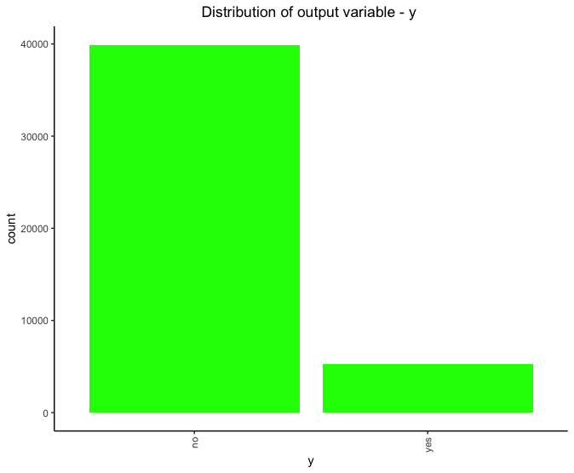
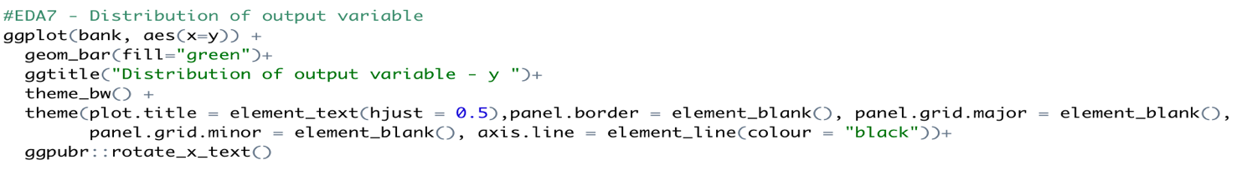
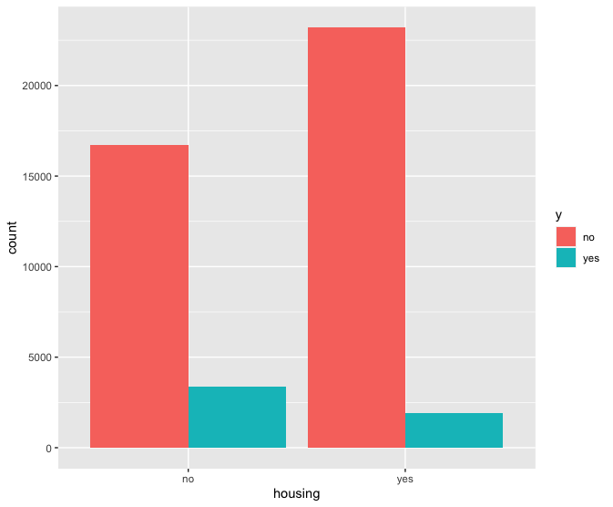
PART TWO
Exploratory Data Analysis
Distribution of output variable – y
This plot shows the distribution of output variable. From the plot we can see that most of the data falls under the category “no”. Which means that a person doesn’t subscribe to a term deposit with the bank.
Observing whether clients having housing loans subscribe for term deposit or not.
From the bar-plot we can state that, clients who don’t have housing loans are more inclined towards subscribing term-deposit as compared to clients who have housing loans.

Slide 12
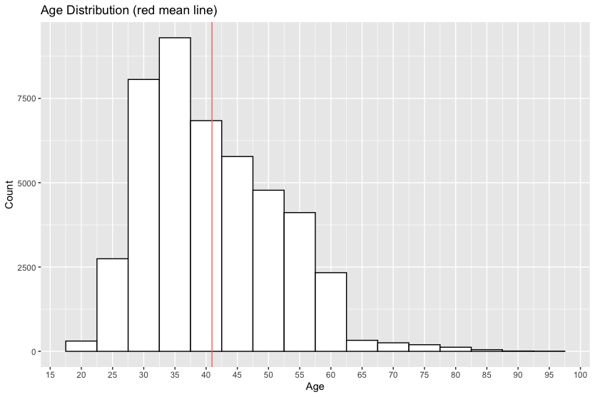
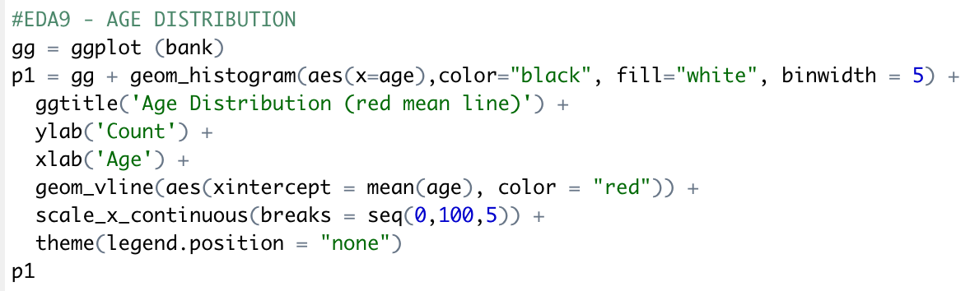
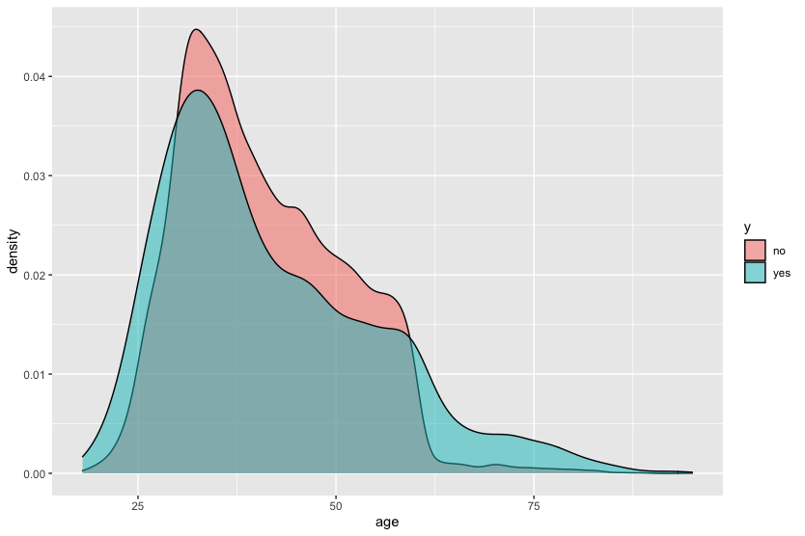
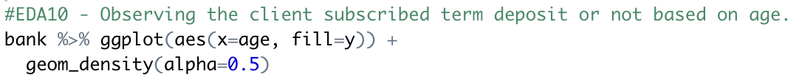
PART TWO
Exploratory Data Analysis
Age Distribution
The bulk of clients are between the ages of 33 (1st Quartile) and 48 (3rd Quartile) with mean lying on 41 visualized on the histogram with red vertical line. Moreover, we can see outliers above the age of 65.
Observing the client subscribed term deposit or not based on age.
Most clients that subscribe are between age 25 to 45. Mean age for all clients is above 40 years of age. Also, we can observe the sharp drop of clients above age 60.

Slide 13
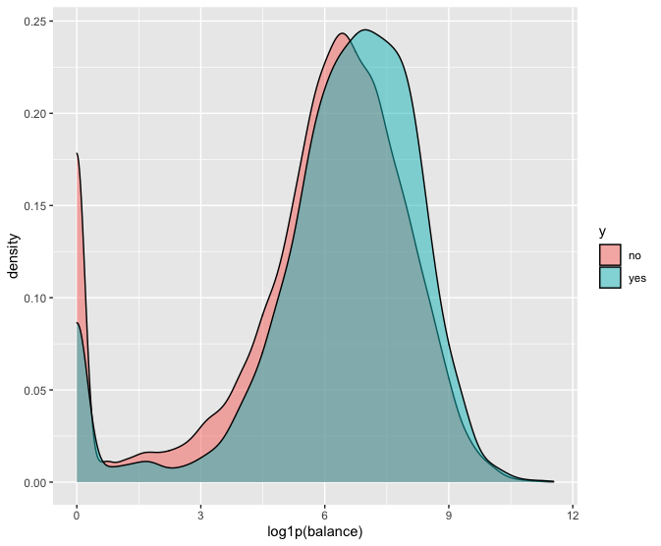
PART TWO
Exploratory Data Analysis
Observing whether clients having balance loans subscribe for term deposit or not.
This plot is designed to shows the relationship between clients subscribing term deposit and clients having balance loans.
Since the distribution range of balance is too large and extremely right skewed, we perform log1p () transformation on balance.
Clients with high balance are usually unwilling to subscribe the term deposit. However, customers with low balance loans are usually willing to subscribe the bank term deposit.

Slide 14
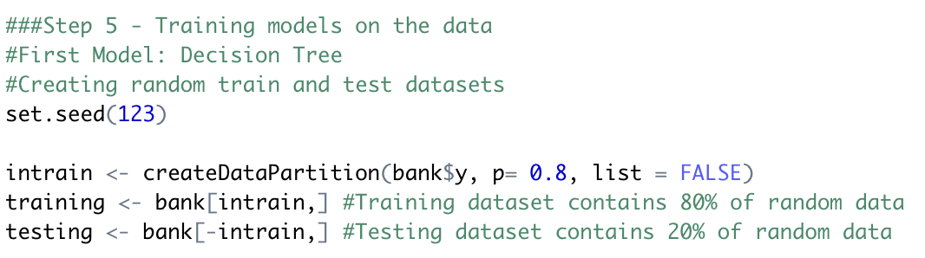
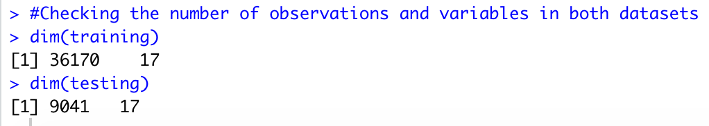
PART THREE
Decision Tree
Decision trees are versatile Machine Learning algorithm that can perform both classification and regression tasks. They are very powerful algorithms, capable of fitting complex datasets.
Data Slicing
Data slicing is a step to split data into train and test set. Training data set can be used specifically for our model building. Test dataset should not be mixed up while building model. Even during standardization, we should not standardize our test set. Test dataset will be used for evaluating model performance i.e. whether the predicted data is correctly classified or misclassified
To make our answers replicable, we need to set a seed value.
The caret package provides a method createDataPartition() for partitioning our data into train and test set.
We are passing 3 parameters.
The “y” parameter takes the value of variable according to which data needs to be partitioned. In our case, target variable is at y, so we are passing bank$y.
The “p” parameter holds a decimal value in the range of 0-1. It’s to show that percentage of the split. We are using p=0.8. It means that data split should be done in 80:20 ratio.
The “list” parameter is for whether to return a list or matrix. We are passing FALSE for not returning a list.

Slide 15
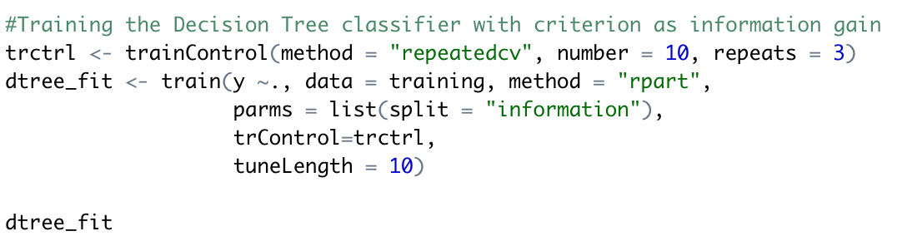
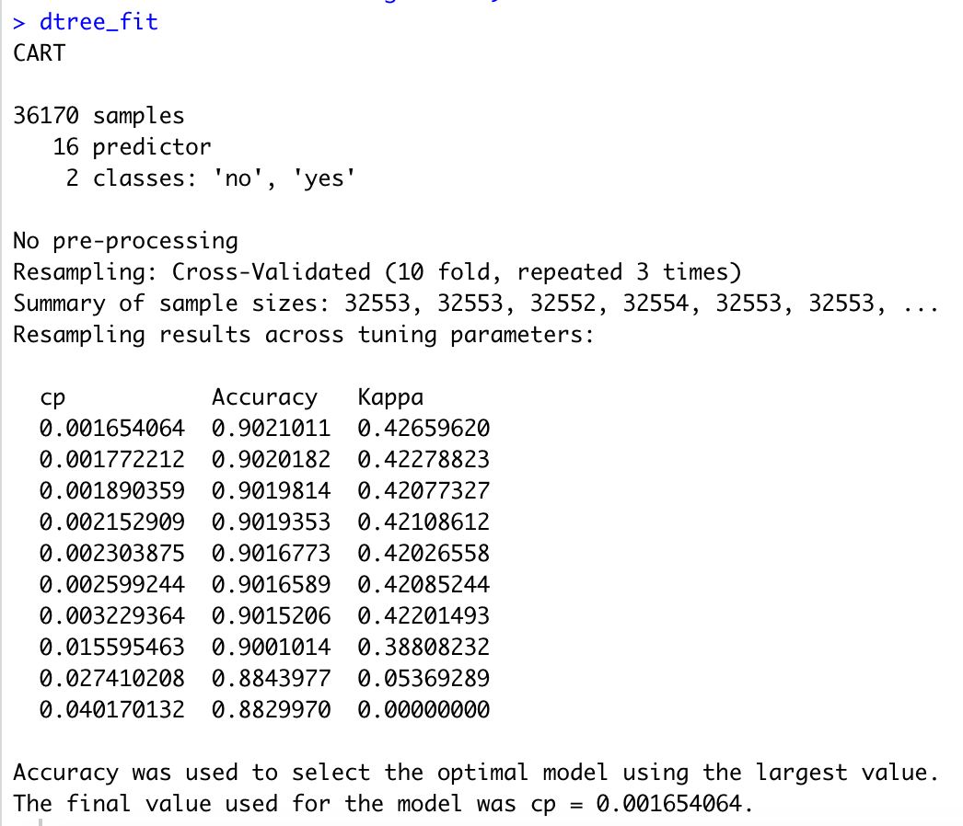
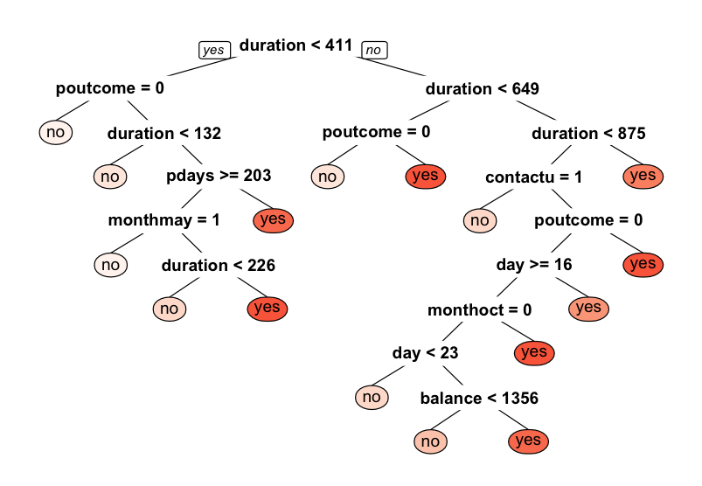
PART THREE
Training the Decision Tree classifier with criterion as information gain
We will first use trainControl() method. It controls the computational nuances of the train() method. We are setting 3 parameters of trainControl() method.
The “method” parameter holds the details about resampling method. Here we are using repeatedcv i.e., repeated cross-validation.
The “number” parameter holds the number of resampling iterations. We are using setting number =10
The “repeats” parameter contains the complete sets of folds to compute for our repeated cross-validation. We are setting it to 3.
This trainControl() methods returns a list. We are going to pass this on our train() method.
We are passing our target variable y. The “y~.” denotes a formula for using all attributes in our classifier and y as the target variable.
We can visualize our decision tree by using prp() method. It indicates its structure and attribute selection for criterion as information gain.

Slide 16
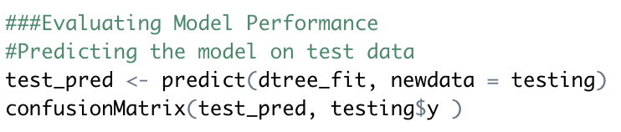
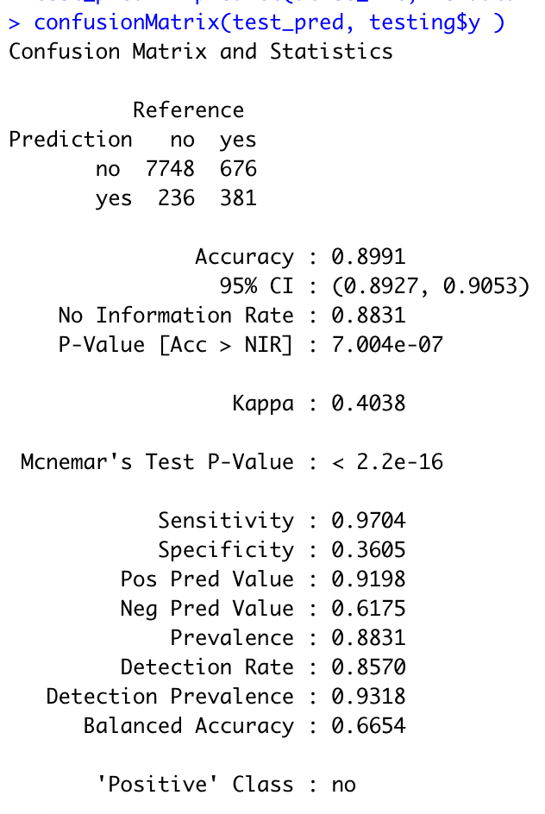
PART THREE
Training the Decision Tree classifier with criterion as information gain
Evaluate Model Performance – Predicting the model on test data
Our model is trained with cp = 0.001654064. Using predict function we will predict classes for our test set.
Using confusionMatrix() function, we can compare the predicted values with the actual values.
The term-deposit variable i.e. the “y” variable is compared with the prediction variable to check the appropriate classification. The data is classified into true positive, true negative, false positive and false negative categories.
The above results show that the classifier with the criterion as information gain is giving 89.91% of accuracy for the test set. It shows that 7748 clients who did not subscribed term deposit were correctly classified showing true positive results. Similarly, 381 clients who did subscribe were also correctly classified showing true negative. But 236 clients who actually did not subscribed but were misclassified as subscribed and 676 who did subscribe but were misclassified as did not are representing false positive and false negative respectively.

Slide 17
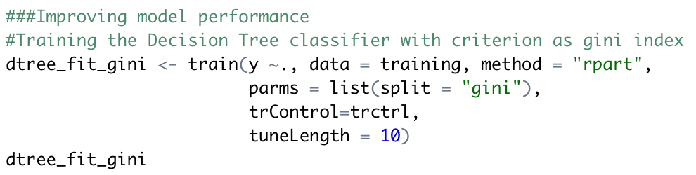
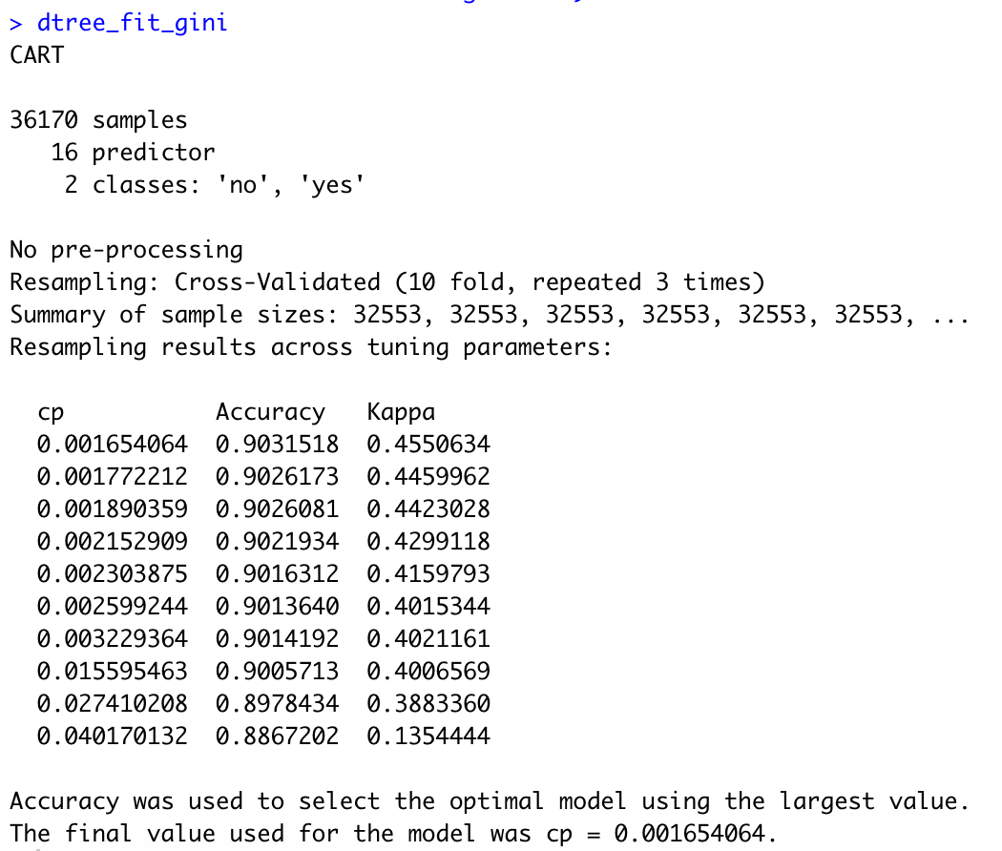
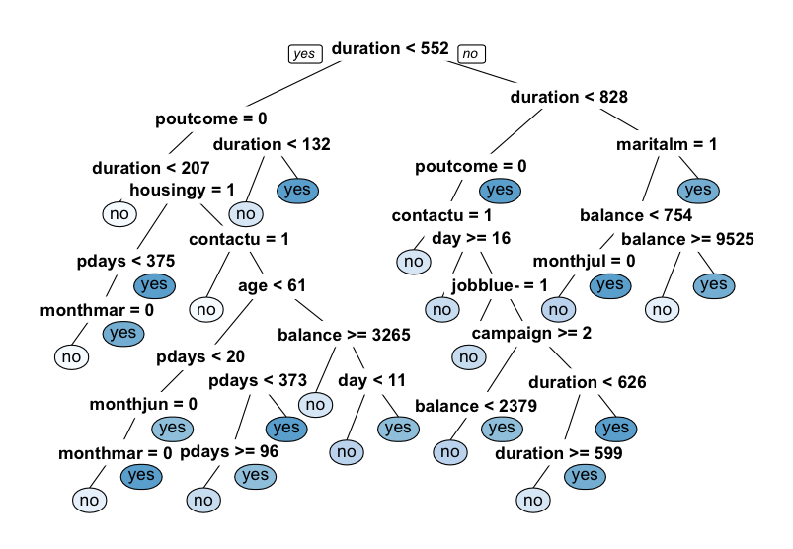
PART THREE
Training the Decision Tree classifier with criterion as Gini index
Let’s try to program a decision tree classifier using splitting criterion as Gini index. It is showing us the accuracy metrics for different values of cp. Here, cp is complexity parameter for our dtree.
Plotting the decision tree
The decision tree visualization shown above indicates its structure. It shows the attribute’s selection order for criterion as Gini index.

Slide 18
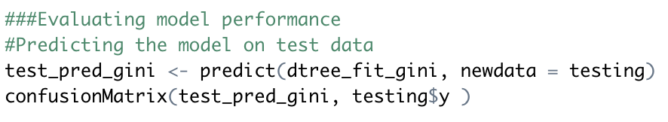
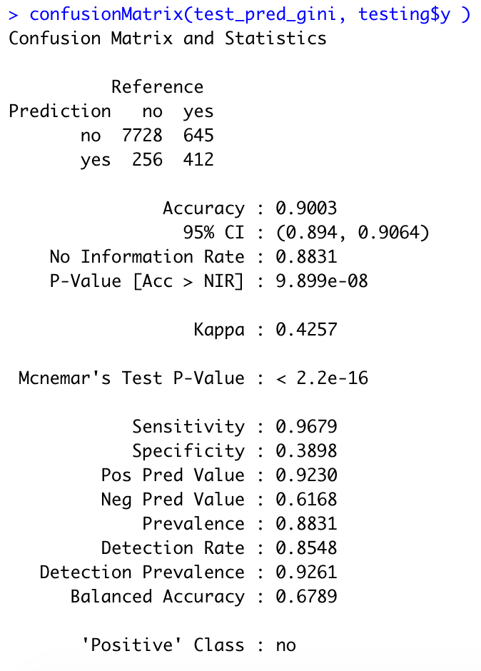
PART THREE
Training the Decision Tree classifier with criterion as Gini index
Evaluate Model Performance – Predicting the model on test data
Our model is trained with cp = 0.001654064. Using predict function we will predict classes for our test set.
The above results show that the classifier with the criterion as Gini index is giving 90.03% of accuracy for the test set. In this case, our classifier with criterion Gini index is giving slightly better results.
It shows that 7728 clients who did not subscribed term deposit were correctly classified showing true positive results. Similarly, 412 clients who did subscribe were also correctly classified showing true negative. But 256 clients who actually did not subscribed but were misclassified as subscribed and 645 who did subscribe but were misclassified as did not are representing false positive and false negative respectively. Moreover, we can also check other parameters like sensitivity, specificity, Positive and negative prediction values, kappa values etc.

Slide 19
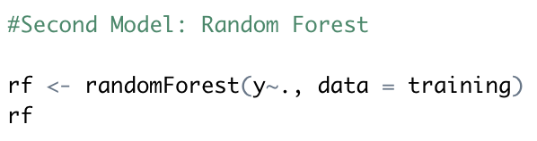
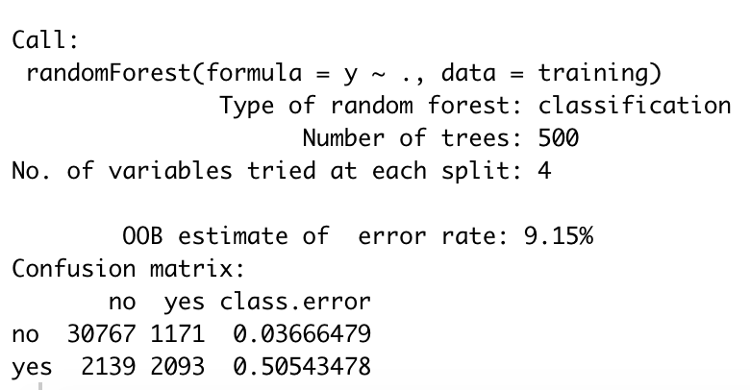
PART FOUR
Random Forest
Random forests are an ensemble learning method that operate by constructing a multitude of decision trees at training time and outputting the class that is the mode of the classes (classification) or mean prediction (regression) of the individual trees. It correct for decision trees habit of overfitting to their training set. In R the main implementation of random forest is found in the randomForest library.
The Random Forest method takes the 17 features from the dataset in which 16 predictors and 1 dependent variable is used for making the Breiman’s random forest classification towards the final decision based on dependent variable.
The syntax for the random forests suggests the classification of the dataset features using multiple variables represented by ‘~’ variable. The random forest provides some basic options to select the number of mtry and tree control variables. By default, the ntree is selected 500 and mtry is selected as 4.
The above statements execute the random forest on the training dataset, the classifier creates an object which is used for making the prediction labels.
The output suggests the proportion of the data used from the factors for building the random forest classifier output. The OOB is out of bag error suggesting the data that is not be used in training and being left for testing purposes and the data will be used when multiple test models are compiled. It is 9.15%
This is the summary of the random forest which gives the output with confusion matrix and description about the classification. This shows the information of the different features with respect to their allocation and misclassification. The confusion matrix also shows the error rate for every factor and its misclassification percentage for the random forest model.

Slide 20
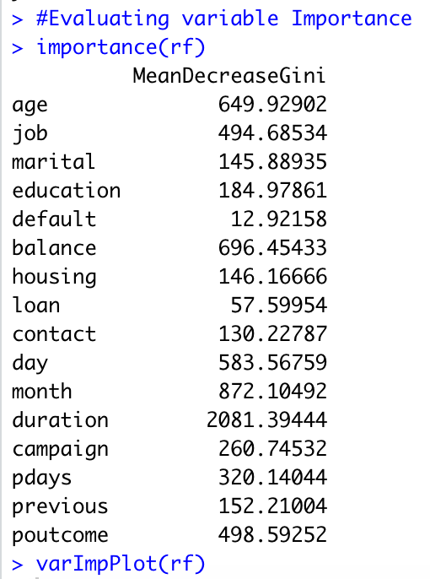
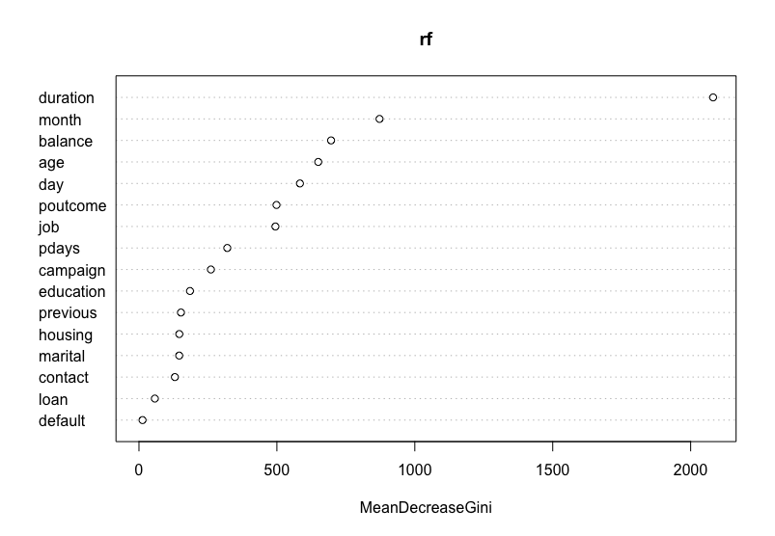
PART FOUR
Random Forest
Evaluating Variable Importance
Using importance(rf) function we can check the importance of each variable in our dataset for random forest model and rule out those variables which are less significant
From the output, we can see that variables like duration, age, balance, month, day, job and poutcome are highly significant as compared to other variables. The same can be depicted in graph format as per the level of significance below using varImpPlot(rf) function in R.
Higher the value of mean decrease accuracy or mean decrease Gini score, higher the importance of the variable in the model. In the plot shown above, Duration is most important variable.

Slide 21
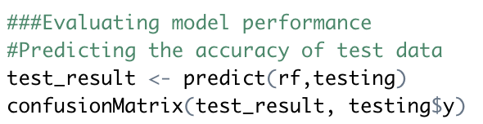
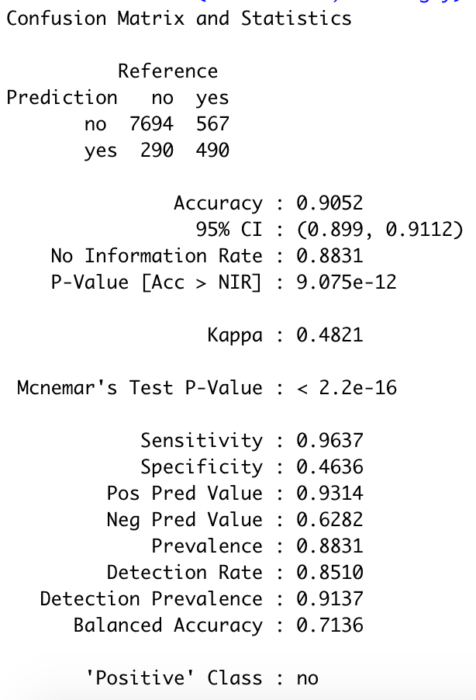
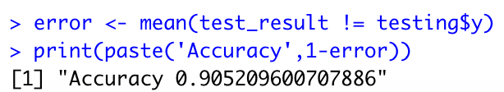
PART FOUR
Random Forest
Evaluate Model Performance – Predicting the model on test data
This step evaluates the performance of the model based on the labels provided. This includes the verification of the results in order to verify whether there are any misclassifications to the model. By using the function “predict”, we can get a vector of predicted values.
The confusion matrix results show that the random forest classifier is giving 90.52% of accuracy for the test set.
The term-deposit variable i.e. the “y” variable is compared with the prediction variable to check the appropriate classification. The data is classified into true positive, true negative, false positive and false negative categories.
Here using confusion matrix, we can compare the predicted values with the actual values. It shows that 7694 clients who did not subscribed term deposit were correctly classified showing true positive results. Similarly, 490 clients who did subscribe were also correctly classified showing true negative. But 290 clients who did not subscribed but were misclassified as subscribed and 567 who did subscribe but were misclassified as did not are representing false positive and false negative, respectively. Moreover, we can also check other parameters like sensitivity, specificity, Positive and negative prediction values, kappa values etc.

Slide 22
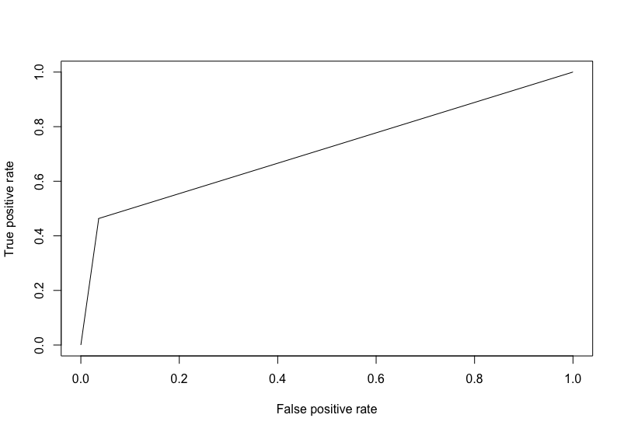
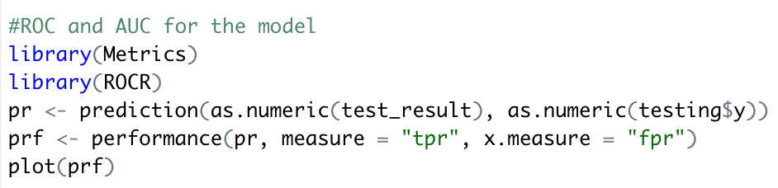
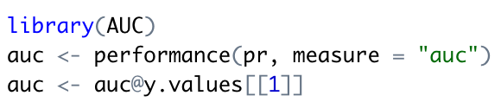
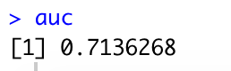
PART FOUR
Random Forest
ROC and AUC for the model
To better inspect the model, we could use Receiver Operating Characteristics Curve which traces the percentage of true positives accurately. There are useful statistics that can be calculated from this curve, like the Area Under the Curve (AUC) and the Youden Index. These tell you how well the model predicts and the optimal cut point for any given model (under specific circumstances). The cutoff is analyzed with the values to identify best threshold.
The figure below describes the graphical presentation of the ROC curve and the area under the curve below states the true positive ratio which is 71.36%.

Slide 23



PART FIVE
Logistic Regression
Logistic Regression is used when the data is linearly separable or classifiable and the outcome is Binary or Dichotomous. The model tries to fit a two-class problem like ham or spam, or malign or benign tumour (i.e. response variable can only take 0 or 1). Logistic regression models the probability of the membership to a group or category without directly modelling the values of the dependent variable.
To build a model using the logistic regression, first we need to set seed using set.seed() function to make our outputs replicable.
We will use trainControl() method. It controls the computational nuances of the train() method. We are setting 4 parameters of trainControl() method. We are going to pass this on our train() method.
We are passing our target variable y in train() function to build GLM model.
The “y~.” denotes a formula for using all attributes in our classifier and y as the target variable.
In method parameter we will pass “glm” which specifies which classification or regression model to use.
The procedure with family="binomial" will build the logistic regression model on the given formula.
From the above model results we can see that there are 16 predictors and 2 classes indicating results as yes or no. There is 10-fold classification as we defined in the code above. Our accuracy in the model is 90.15% and kappa is 40.43%. Kappa is the measure of inter-rater agreement.

Slide 24


PART FIVE
Logistic Regression
Evaluate Model Performance – Predicting the model on test data
For evaluating the logistic regression prediction model we will use predict.train() function. In that we will pass our glm model which we created above and run it on our testing dataset.
This function has a parameter type which takes 2 inputs either “raw” or “prob”. For predict.train, a vector of predictions if type = "raw" or a data frame of class probabilities for type = "probs". In the latter case, there are columns for each class.
The confusion matrix results below show that the logistic regression model is giving 90.03% of accuracy for the test set.
The term-deposit variable i.e. the “y” variable is compared with the prediction variable to check the appropriate classification. The data is classified into true positive, true negative, false positive and false negative categories.
Here using confusion matrix, we can compare the predicted values with the actual values. It shows that 7795 clients who did not subscribed term deposit were correctly classified showing true positive results. Similarly, 345 clients who did subscribe were also correctly classified showing true negative. But 189 clients who did not subscribed but were misclassified as subscribed and 712 who did subscribe but were misclassified as did not are representing false positive and false negative, respectively. Moreover, we can also check other parameters like sensitivity, specificity, Positive and negative prediction values, kappa values etc.

Slide 25




PART FIVE
Logistic Regression
ROC and AUC for the model
To better inspect the model, we could use Receiver Operating Characteristics Curve which traces the percentage of true positives accurately. There are useful statistics that can be calculated from this curve, like the Area Under the Curve (AUC) and the Youden Index. These tell you how well the model predicts and the optimal cut point for any given model (under specific circumstances). The cutoff is analyzed with the values to identify best threshold.
The figure below describes the graphical presentation of the ROC curve and the area under the curve below states the true positive ratio which is 65.13%.

Slide 26


PART FIVE
EXPLAIN GLM MODEL
For creating an explainer, we will use DALEX package in R.
It xrays any model and helps to explore and explain its behaviour. It contains various methods that help to understand the link between input variables and model output.
The DALEX architecture can be split into three primary operations:
Any supervised regression or binary classification model with defined input (X) and output (Y) where the output can be customized to a defined format can be used.
The machine learning model is converted to an “explainer” object via DALEX::explain(), which is just a list that contains the training data and meta data on the machine learning model.
The explainer object can be passed onto multiple functions that explain different components of the given model.
Although DALEX does have native support for some ML model objects. To make DALEX compatible with these objects, we need three things:
x: Our feature set needs to be in its original form.
yTest: Our response variable needs to be a numeric vector. For regression problems this is simple, as it will already be in this format. For binary classification this requires you to convert the responses to 0/1.
P_fun: a custom predict function that returns a vector of numeric values. For binary classification problems, this means extracting the probability of the response.
Once we have these three components, we can create explainer objects for GLM model.
From the above results we can see that a new explainer is initiated where the model label is glm, the data consist of 9041 rows and 17 columns in the test data. The model is using caret package to build a model and predicted values are max 0.9998 & mean is 0.112. Moreover, residuals ranges from -0.9991 to max 0.9980 where mean is 0.0044.

Slide 27



PART FIVE
Residual diagnostics
Now let’s see the reverse cumulative distribution of the residuals. Assessing residuals of predicted versus actuals can allow you to identify where models deviate in their predictive accuracy. We can use DALEX::model_performance to compute the predictions and residuals. Printing the output returns residual quantiles and plotting the output allows for easy comparison of absolute residual values across models.
From the results, we can see that our accuracy is 90.03% and residual percentages are increasing along with increase in the percentages. Let’s see the graphical presentation of the cumulative distribution of residual as follows.

Slide 28
PART SIX
Results and Conclusion
The algorithms used on the data set consist of decision trees, random forest and logistic regression which show an average accuracy of 90% approx. We can notice that in all three models, sensitivity is lower compared to specificity. A possible explanation for this may be because of the distribution of the output variable (most of the observations fall under “no”).
From our analysis we discovered the levels of those variables that produce most term deposit purchases. For instance, the longer the duration of the call is, it is highly possible for the client to subscribe term deposit.
There are many variables that impact the decision of clients to purchase term deposits. Like what kind of jobs they have?, do they have housing loans?, what is the client's education level?, Are they married, single or divorced? And in what age group do they lie in? etc.
Knowing the variables that provide the highest odds of success are important to a bank. A bank can use these variables to target Clients that would most likely make term deposit purchases.
In this project we have implemented machine learning techniques to a Portuguese bank marketing data and tried understanding the factors that influence subscription to the term deposit. Multiple classification algorithms have been implemented. Cross validation was used for parameter selection in decision trees.
REFERENCES
Moro, S., Cortez, P., & Rita, P. (2014, June). Bank Marketing Data Set. Retrieved from
https://archive.ics.uci.edu/ml/datasets/bank marketing#

